Slide 1
Augment Reality
20191757 Ji-Yun Seo

Slide 2
Self Introduction
Name : Ji Yun Seo
Birth data : 2 April 1992
Nationality : Korea
Research : Health care, Bio-Signal processing
Interested Topic : Health care, DB
Back ground
2010-2017
Division of Computer Engineering, Dongseo University
2017-2019
M.Sc Ubiquitous IT, Dongseo University
2019-Current
Ph.D. Computer Engineering, Dongseo University

Slide 3
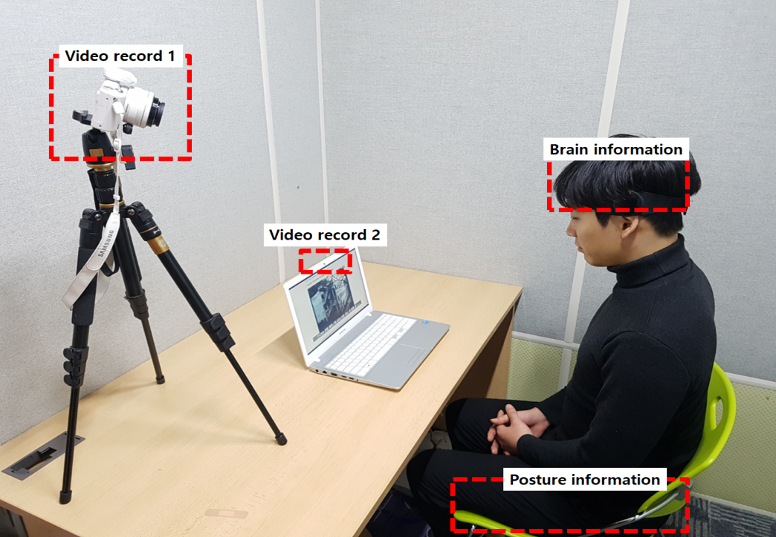
Research Topic
Sensor Fusion based Distraction Monitoring System
Estimation of distraction index according to posture change rate and comparative analysis with EEG

Slide 4
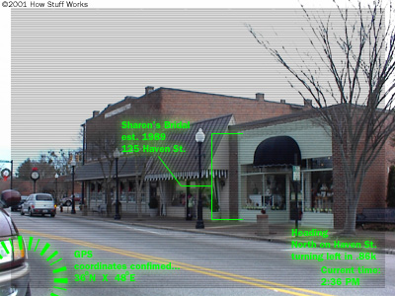
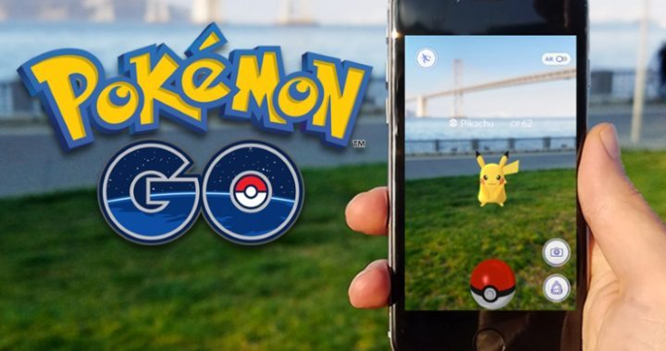
What is Augmented Reality(AR) ?
Augmented Reality is a combination of a real scene viewed by a user and a virtual scene generated by a computer that augments the scene with additional information.
- Combines real and virtual world aspects
- Is interactive in real-time
- Is registered in three dimensions

Slide 5
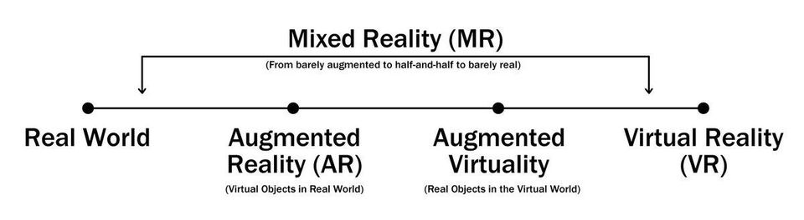
Difference between AR and VR
AR (Augmented Reality)
VR (Virtual Reality)
System augments the real world scene
User maintains a sense of presence in real world
Needs a mechanism to combine virtual and real worlds
Totally immersive environment
Senses are under control of system
Need a mechanism to feed virtual world to user

Slide 6
How does AR work ?
The basic idea of augmented reality is to superimpose graphics, audio and other sense enhancements over a real-world environment in real-time.
The graphics will then change to accommodate the user’s eye or head movements.
There are three components needed in order to make an AR system work:
Head-mounted display
Tracking system
Mobile computing power

Slide 7
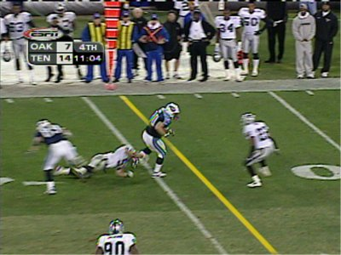
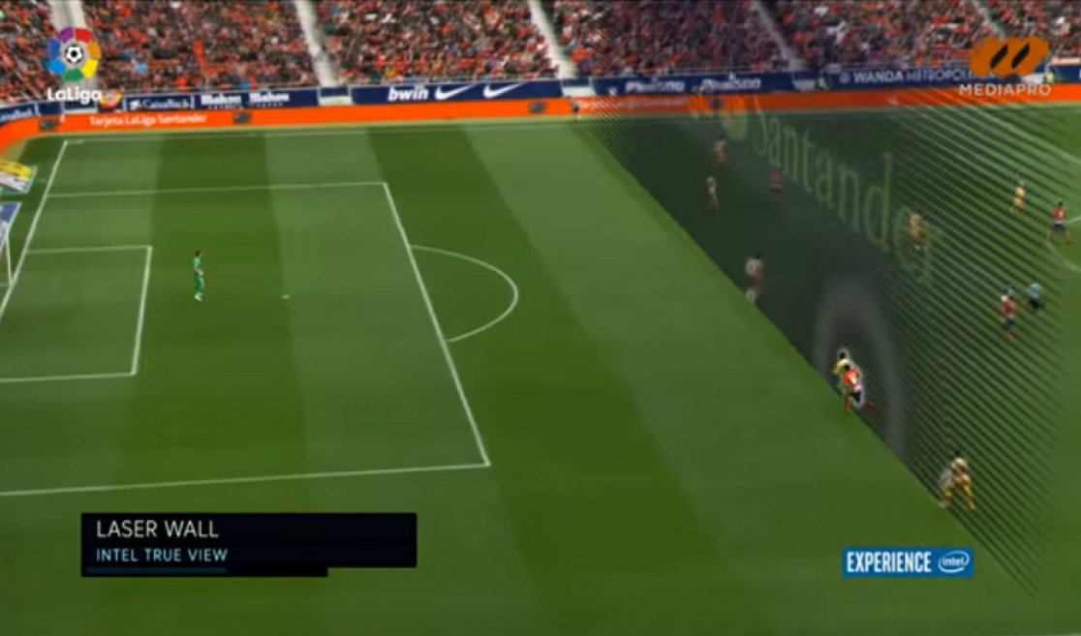
Current uses of AR
Yellow line(offside) used on TV broadcasts of sports games:
Real world elements: football field and players
Virtual element: the yellow line drawn over the image by computers in real-time

Slide 8
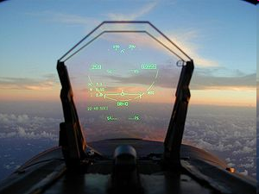
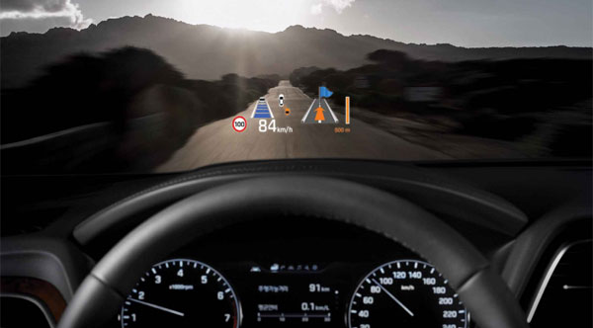
Current uses of AR
HUD (Head Up Display):
Used in commercial aircraft, automobiles, and other applications
Presents data without requiring the user to look away from his or her usual viewpoint

Slide 9
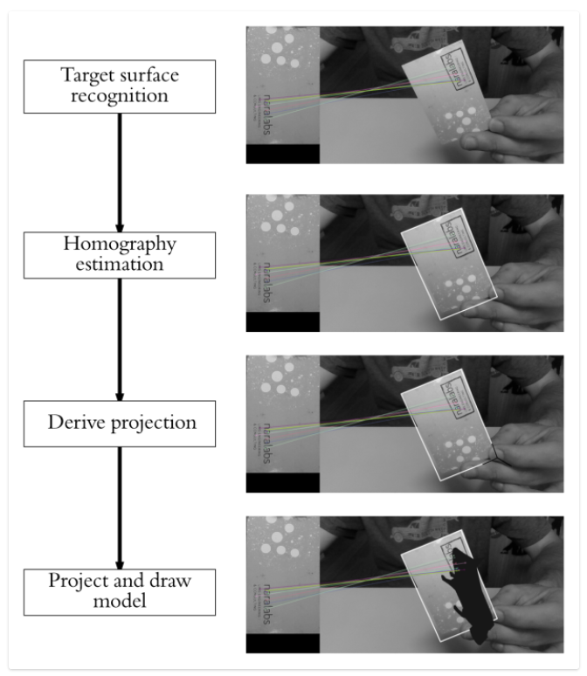
AR Processing for Simulation
Recognize the reference flat surface
Estimate the homography
Derive from the homography the transformation from the reference surface coordinate system to the target image coordinate system
Project our 3D model in the image (pixel space) and draw it

Slide 10

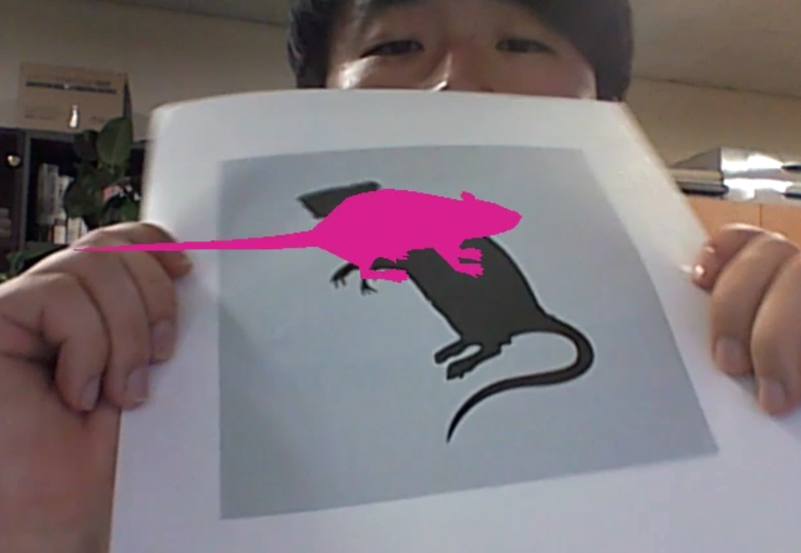
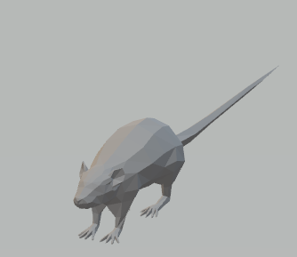
Simulation & Result
code
video
Reference image
Result
object

